Slide 1


V2U
CONSULTING SERVICES PVT. LTD.

Slide 2



ABOUT US
We are a group of individuals who specialize in their respective areas. We have come together under a common Umbrella to offer our services. We provide professional services under various verticals and domains. Our goal is to help individuals and organizations achieve their business goals and dreams. SR Consultancy is a consulting firm focused on making the clients successful through innovative business solutions. Our goal is to help individuals and organizations achieve their business goals and dreams. V2U is a consulting firm focused on making the clients successful through innovative business solutions.

Slide 3
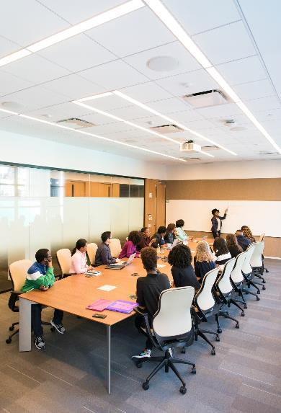

OUR COMPANY
BPO
KPO
IT Services
Non-IT Services
Supply Chain Management
Transportation
Corporates Trainings
Accounting

Slide 4




Service 1
Our Services
Transportation, Supply Chain Management, Logistics
A team that can tackle your toughest issues. Be it product, people, costs, productivity or quality, we have the experience to turn your problems into permanent solutions.
A price based on the value of the work. You can rest assured that the price quoted is the price charged.
A trusted ally that provides advice to help you make your big decisions the right ones.
Solutions that can be put into action.
Service 2
BPO, KPO, IT, Non-IT Services
Service 3
Corporate Training, Accounting

Slide 5


WHY LOGISTICS
WHY SUPPLY CHAIN MANAGEMENT

Slide 6
KUSHAGRA GUPTA
DIRECTOR
V2U CONSULTANCY SERVICES PVT LTD
PRIYANKA GUPTA
HUMEN RESOURCES HEAD
V2U CONSULTANCY SERVICES PVT LTD
MEET OUR TEAM
SHUBHAM SHARMA
OPERATION HEAD
V2U CONSULTANCY SERVICES PVT LTD
PRATEEK ARYA
SALES HEAD
V2U CONSULTANCY SERVICES PVT. LTD.

Slide 7








V2U’s vision is to make this company a target of 1 million in the coming 1 year and we want to be a partner in the growth of India by hiring 500+ employees in this company by the end of 2022
VISION STATEMENT

Slide 8

AMBIENCE
Right now we are trying to get the more business from the US client and our Business Development team is doing there best to get the achieve the goal. We are creating the environment and ambience for every employee which helps them grow themselves and will help them to develop there skills.

Slide 9




OUR GOAL AND TARGET
GOAL
TARGET ACHIEVE
We want to complete the team in our office 500+ employee by the end of the 2022
We want to become a 1 Million Doller company by the end of the 2022

Slide 10



CONTACT US
Sector 57, Gurgaon, Haryana
v2uconsultancyservices@gmail.com
700-719-9397

Slide 11
Thank You!

